Slide 1


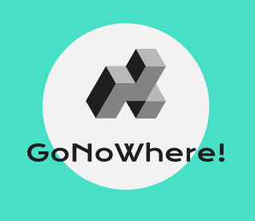
GoNoWhere!
Web Application
A Web Application that will provide all the necessities directly to your home.
Notes:
Photo by Jeremy Beadle on Unsplash

Slide 2


Group Members
Lakshmikanth Mhetre
Prathamesh Bhamanage
Arihant Kote
Abhiraj Chavan
GoNoWhere!
Notes:
Photo by You X Ventures on Unsplash
Photo by Drew Beamer on Unsplash

Slide 3

Introduction to GoNowhere!
The project is based on providing all the home based services that is needed. Many services will be provided that is needed in a home such as laundry, shifting, painting, electrician, plumber, tutoring etc. The project is useful to get work and to get work done.
There will be specifically two type of user:-
1. People who provide services (Employee)
2. People who use services (Client)
GoNoWhere!
Notes:
Photo by Alesia Kazantceva on Unsplash

Slide 4

Why GoNoWhere!
In this modern age there is huge increase in need for ease of lifestyle. People are getting lazy / busy, need a helping hand and prefer to do everything from home with the help of internet. So in this product with the help of internet we provide people what they want i.e. ease of life.
Old ,handicapped and other people can easily hire people, without any need to go any where.
GoNoWhere!
Notes:
Photo by Michael Aleo on Unsplash

Slide 5
Scope Of Project
There are several online home service provider and they are used by many people in the world, but not most of the people use this feature, as they don’t have much faith and the costing aren't very comfortable. By validating the employee and collecting the data in areas we can make people to use this feature with full faith. By collecting references and data we can provide people what they require.
Any one can use this website.
GoNoWhere!
Notes:
Photo by You X Ventures on Unsplash
Photo by Drew Beamer on Unsplash

Slide 6



Goals,Feature and Limitation of Product.
Product Goals
Product Featurs
Product Limitation
Provide a delightful and memorable home service to customer and creating jobs for people .That leads better to standard of living for mankind .
Online home services.
Proper and regional costing.
For both client and employee.
Before getting a service the employee must accept the job.
\item The pricing may not be related with specific areas.
Notes:
Photo by Jay Wennington on Unsplash
Photo by Goran Ivos on Unsplash
Photo by Mel on Unsplash

Slide 7
What our product will create in society
To create a society with better standard of living.
03
Replicate the traditional employee and employer relationship online.
02
04
Saves time and money as well.
To provide online home service to the people.
01
05
Employment.
Notes:
Photo by Sergey Zolkin on Unsplash

Slide 8

System Architecture Modules
A Client who needs his work to be done.
Client
Employee
Employee who wants work for income.
Our Product will provide connection and communication between client and employee.
GoNoWhere!
Notes:
Photo by Jeremy Beadle on Unsplash

Slide 9
Employee and Client Module
EMPLOYEE
Registers for work at our website with his or her skills.
The request is then accepted by employee,and complets the requested work.
PRODUCT MODULES
02
03
04
CLIENT
Select work and employee to be employed, and send requuest.
After completing the requested work he or she is to pay to the employee.
01
Notes:
Photo by Tyler Franta on Unsplash

Slide 10

Steps for Client
01
02
03
04
User Registration and Login
Search For Service
Apply For Request
Service Attained
The first step for user is to register and login. The users credentials will be validated.
After logging in the user will search for the required service.
Apply a request forService.
The request will be then sent to the employee.
The employee will fulfill the asked service and get paid for his job done.
Notes:
Photo by Craig Garner on Unsplash

Slide 11
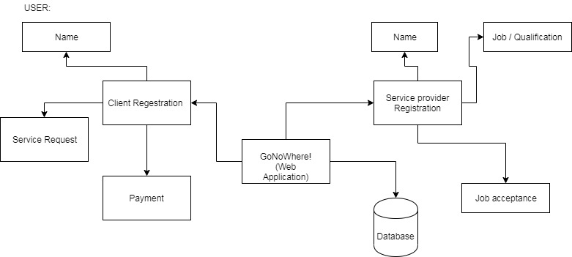
System Architecture
GoNoWhere!

Slide 12
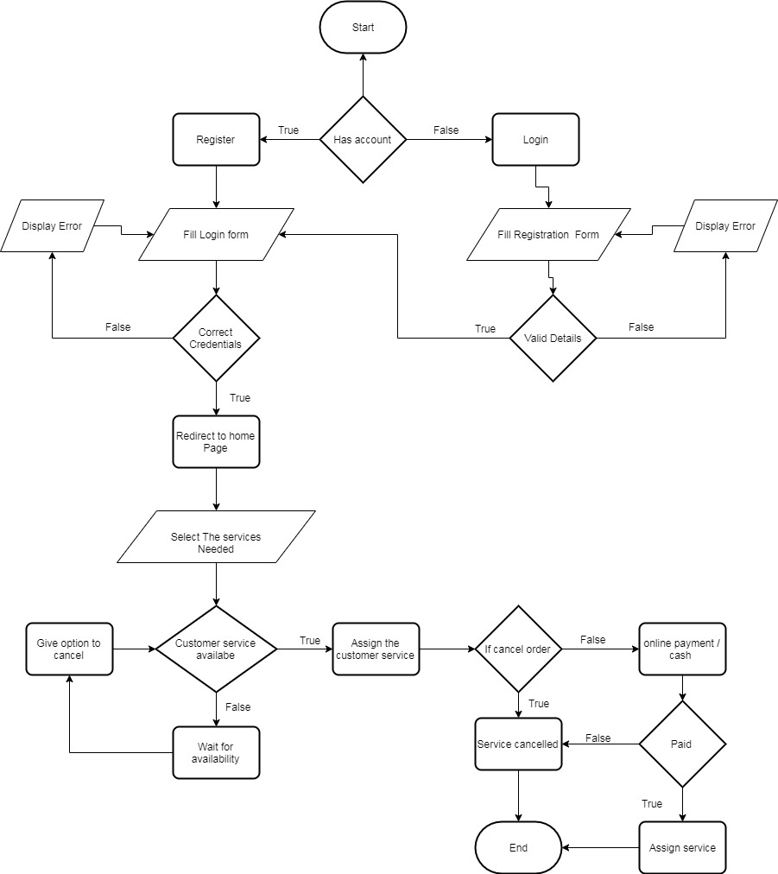
Flow Chart
GoNoWhere!

Slide 13
Advantages and Disadvantage
Advantage
Time Saving.
Helpful for people who are New in Town people.
Quality Service.
Punctuality of work completed is maximised.
Cost-Effective.
Increased professionalism.
Global access, 24 hours a day, 7 days a week.
Improved client service through greater flexibility..
Disadvantage
You become unsocial.
Weakening of communication and bargaining skills.
Technical problems (server crashes, network down time, etc).
Notes:
Photo by Michael Aleo on Unsplash

Slide 14
Stack for our Project
01
02
03
Front End
Back End
Database
HTML
JavaScript
BOOTSTRAP
CSS
jQuery
SQL Based Database.(MySQL)
PHP.
NODE JS
Notes:
Photo by Jeremy Beadle on Unsplash

Slide 15
Estimated System Configuration.
Hardware Requirements
Software Requirements
Permission
Processor - i3(min)
RAM - 1 GB(min)
Internal Storage - 16 GB(min)
Operating System -Any
Web Browser -Google/Firefox/Opera
Cookie Accessibility
File creation and access.
GoNoWhere!
Notes:
Photo by Jay Wennington on Unsplash
Photo by Goran Ivos on Unsplash
Photo by Mel on Unsplash

Slide 16
References used for GoNoWhere!
1. Amazon Home Services.
2. Handy Home Services.
3. Global Online On Demand Home Services Market
4. Online home services
Notes:
Photo by Tran Mau Tri Tam on Unsplash

Slide 17

THANK
YOU
Any Questions ?
Notes:
Photo by Andreas Dress on Unsplash

